Slide 1
Savings from Appliance Standards
Joanna Mauer
Appliance Standards Awareness Project
CFA Member Briefing
October 7, 2020

Slide 2
Background
Appliance and equipment standards specify minimum efficiency levels for specific products
Apply to appliances and equipment manufactured or imported for sale into the U.S.
First national standards established in 1987
~ 60 products covered by existing standards

Slide 3
Historical declines in energy use: refrigerators

Slide 4
Historical declines in energy use: clothes washers

Slide 5
Historical declines in energy use: dishwashers

Slide 6
As refrigerator, clothes washer, and dishwasher energy consumption has decreased . . .
Performance generally stayed the same or improved
Products included new features
Prices declined

Slide 7
Existing standards are providing large utility bill savings and CO₂ reductions
$500/year in savings for an average household
$63 billion in utility bill savings in 2015
$2 trillion in cumulative utility bill savings through 2030
7.9 billion tons in cumulative CO₂ reductions through 2030

Slide 8
But there are still huge opportunities for additional savings
In 2016, we found that by 2050, updates to existing standards could:
  Save consumers and businesses $65 billion on their annual utility bills
  Reduce annual CO₂ emissions by 200 MMT
Up-to-date estimates coming soon . . .

Slide 9
Trump administration has failed to deliver any of these savings
No updates to standards completed
28 missed deadlines for reviewing appliance standards
Rollback of light bulb standards
Revised “Process Rule”
Others in the works

Slide 10
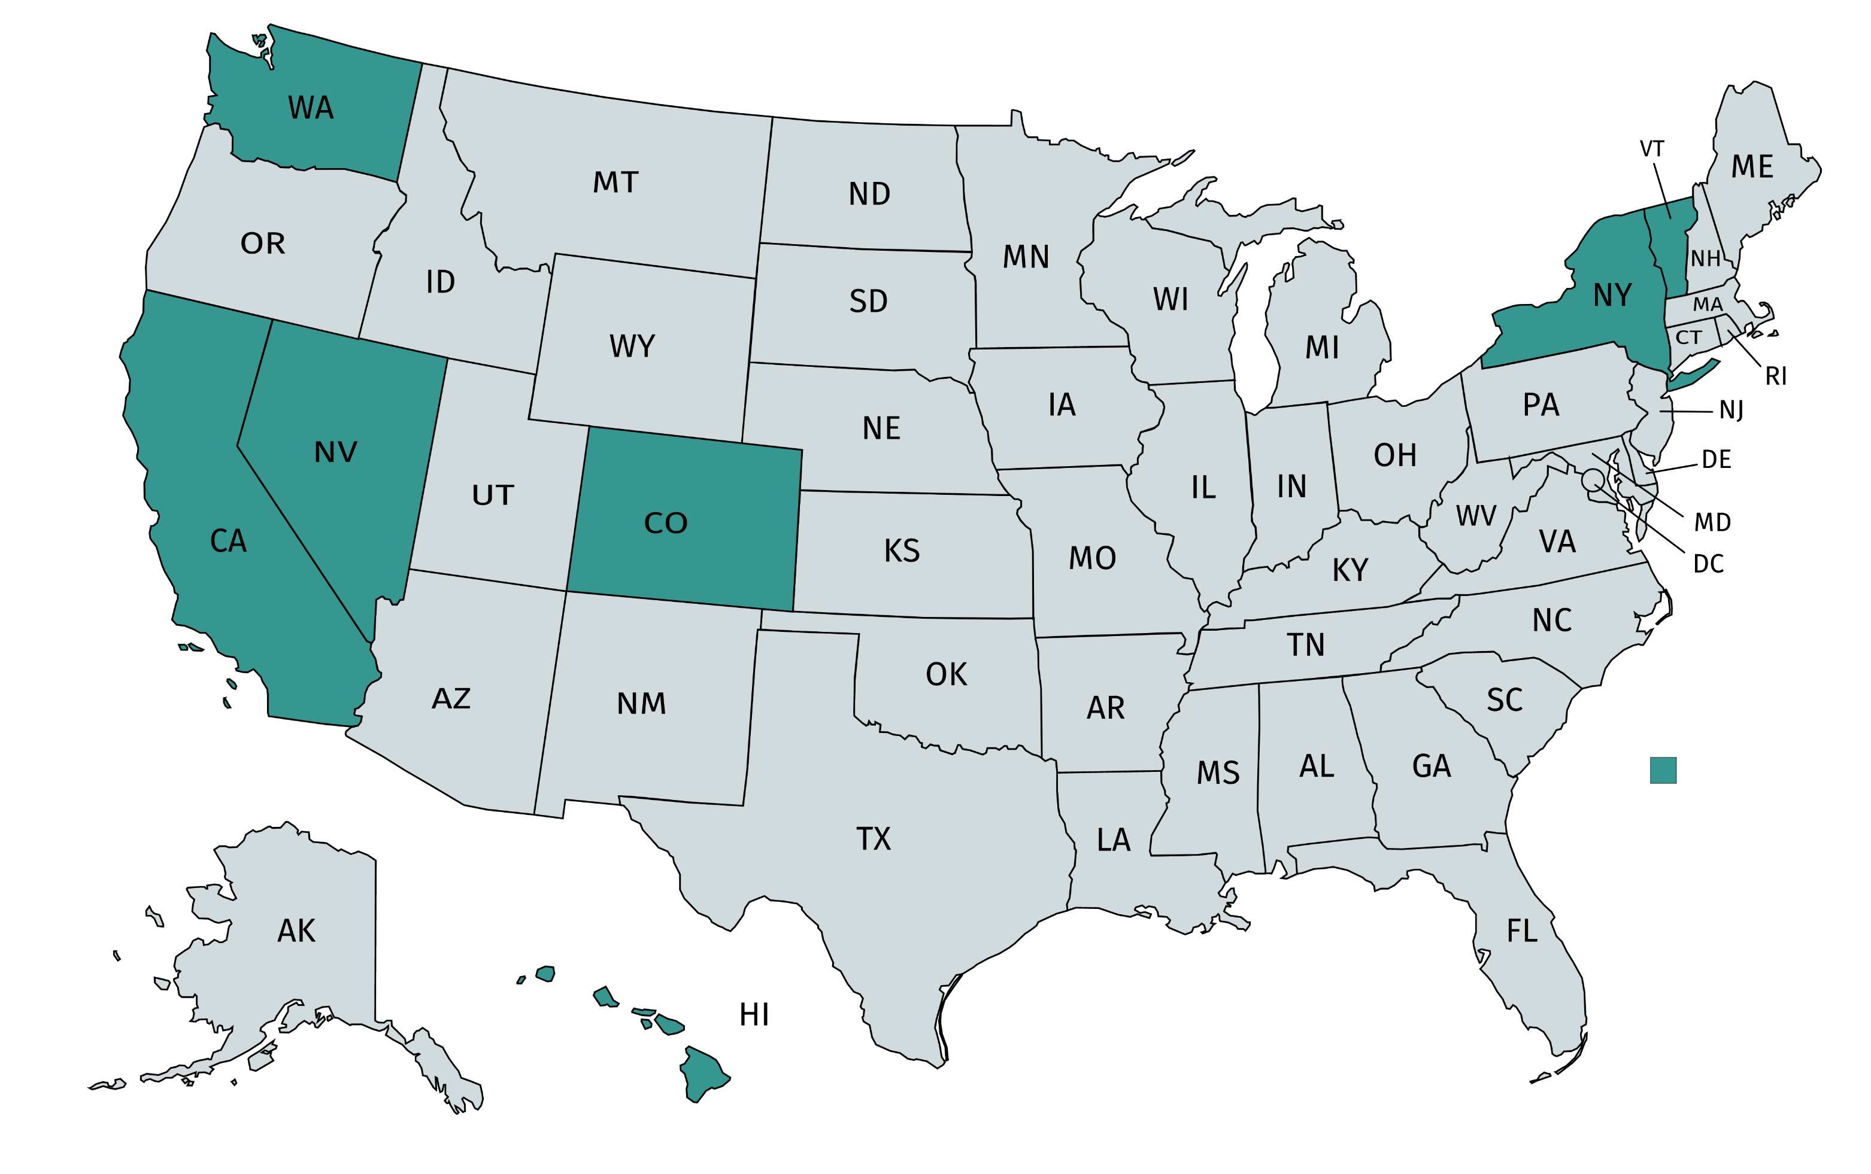
States have stepped up
States adopting state-level appliance standards since 2018

Slide 11
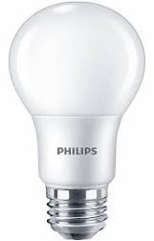
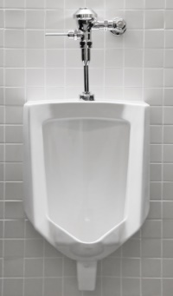
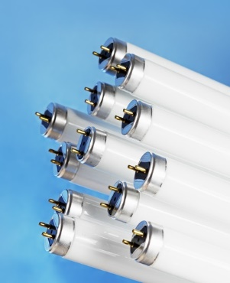
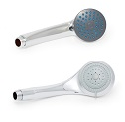
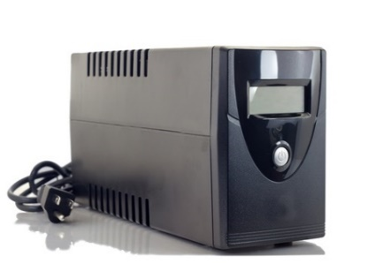
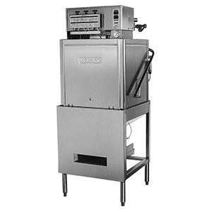
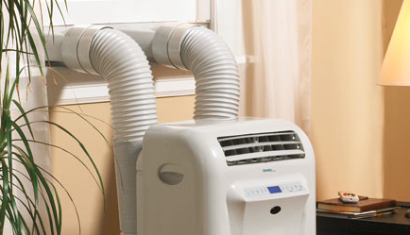
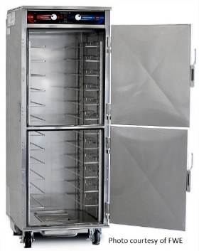
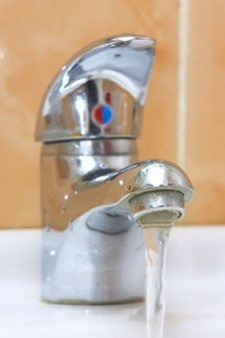
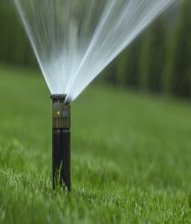

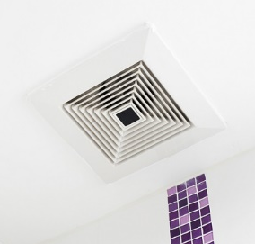

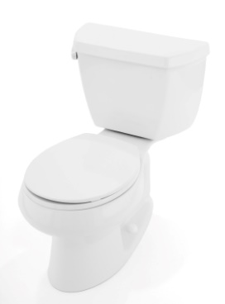
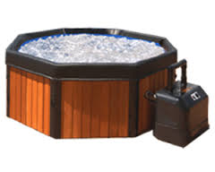
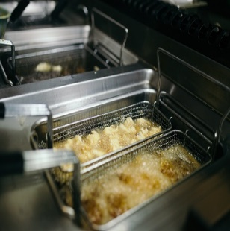
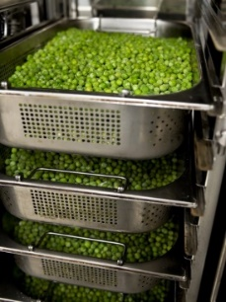
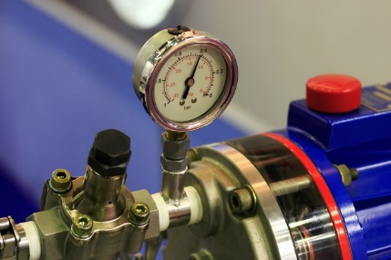
Products in state standards packages

Slide 12
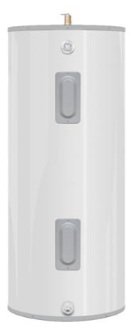
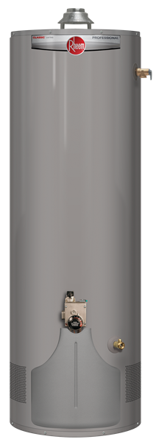
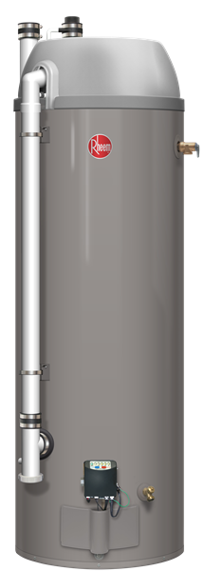
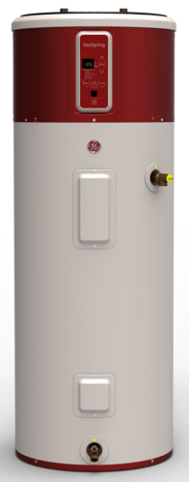
Future potential savings: water heaters
Electric water heaters: >60% savings
Gas water heaters: >20% savings
Electric resistance
Heat pump
Conventional
Condensing

Slide 13
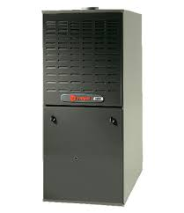
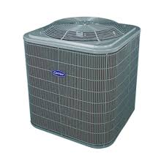
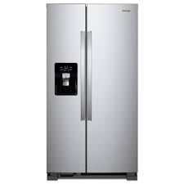
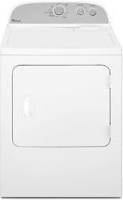
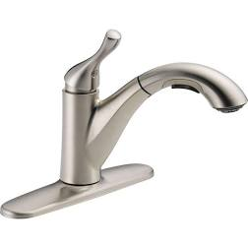
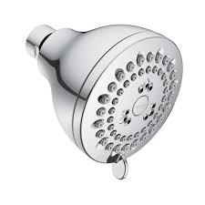
Additional large potential future savings
Furnaces: 20% savings
ACs/heat pumps: 10-15%+ savings
Refrigerators/freezers: 15-20% savings
Clothes dryers: 30% savings
Faucets: 20-45% savings
Showerheads: 30% savings

Slide 14
  Joanna Mauer
  505-508-2910
  jmauer@standardsASAP.org
  www.appliance-standards.org

