Slide 1



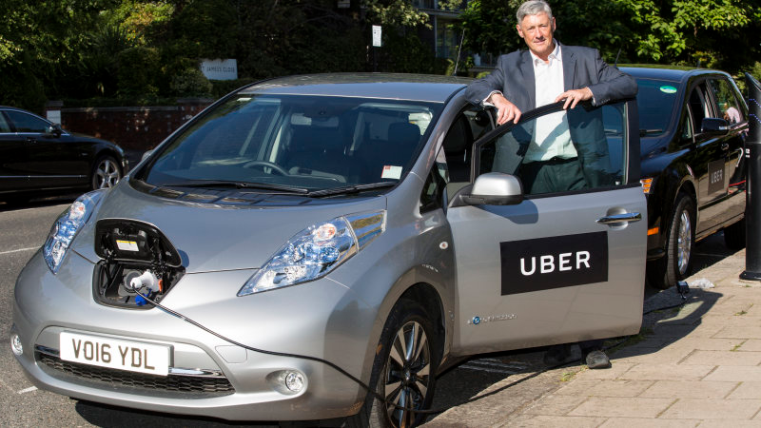
Using Energy Efficiency to Get Halfway to Decarbonization in the U.S.
Steven Nadel, Executive Director
Presentation to CFA
October 2020
Notes:
[Lauren]

Slide 2
Non-profit research organization
Founded in 1980
65 staff and $10 million/year budget
Act as a catalyst to advance energy efficiency policies, programs, technologies, investments, & behaviors
Funding comes from foundations, government agencies, contracts, conferences and corporate memberships
aceee.org @ACEEEdc

Slide 3
America’s Clean Energy Frontier
Source: NRDC, 2017

Slide 4
Opportunity Analysis: Energy Savings
49% savings
Source: ACEEE, 2019, Halfway There

Slide 5
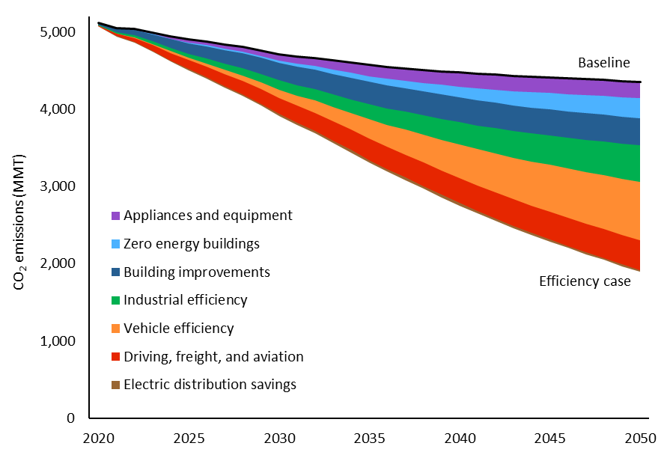
Opportunity Analysis: Emissions Reductions
57% reduction in CO2, 49% reduction in all GHG
Source: ACEEE, 2019, Halfway There

Slide 6
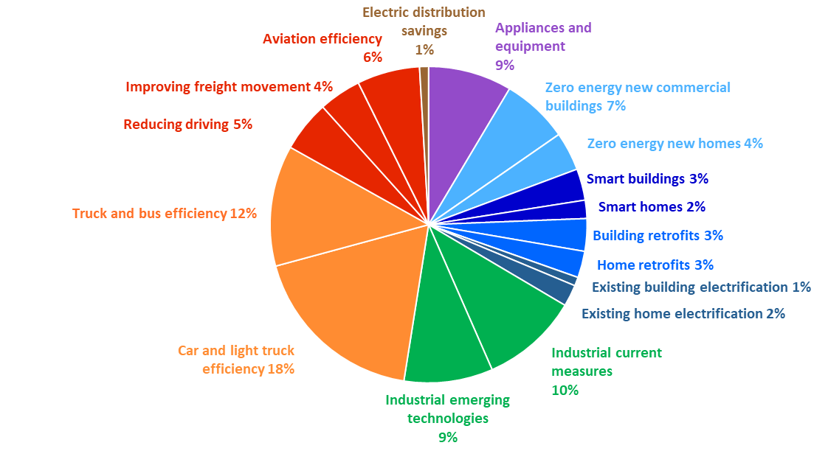
Allocation of Emissions Reductions by Opportunity
Existing
Buildings
14% of
total

Slide 7

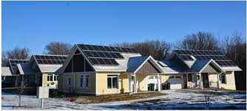
Zero Energy/Carbon New Homes & Buildings
Efficient design of new homes and commercial buildings (zero energy ready) and use of renewable electricity to meet average annual loads.
Most of these buildings are all or mostly electric
Need voluntary programs to promote ZEBs (includes state & local govts. leading by example)
Reach codes for leading jurisdictions

Slide 8
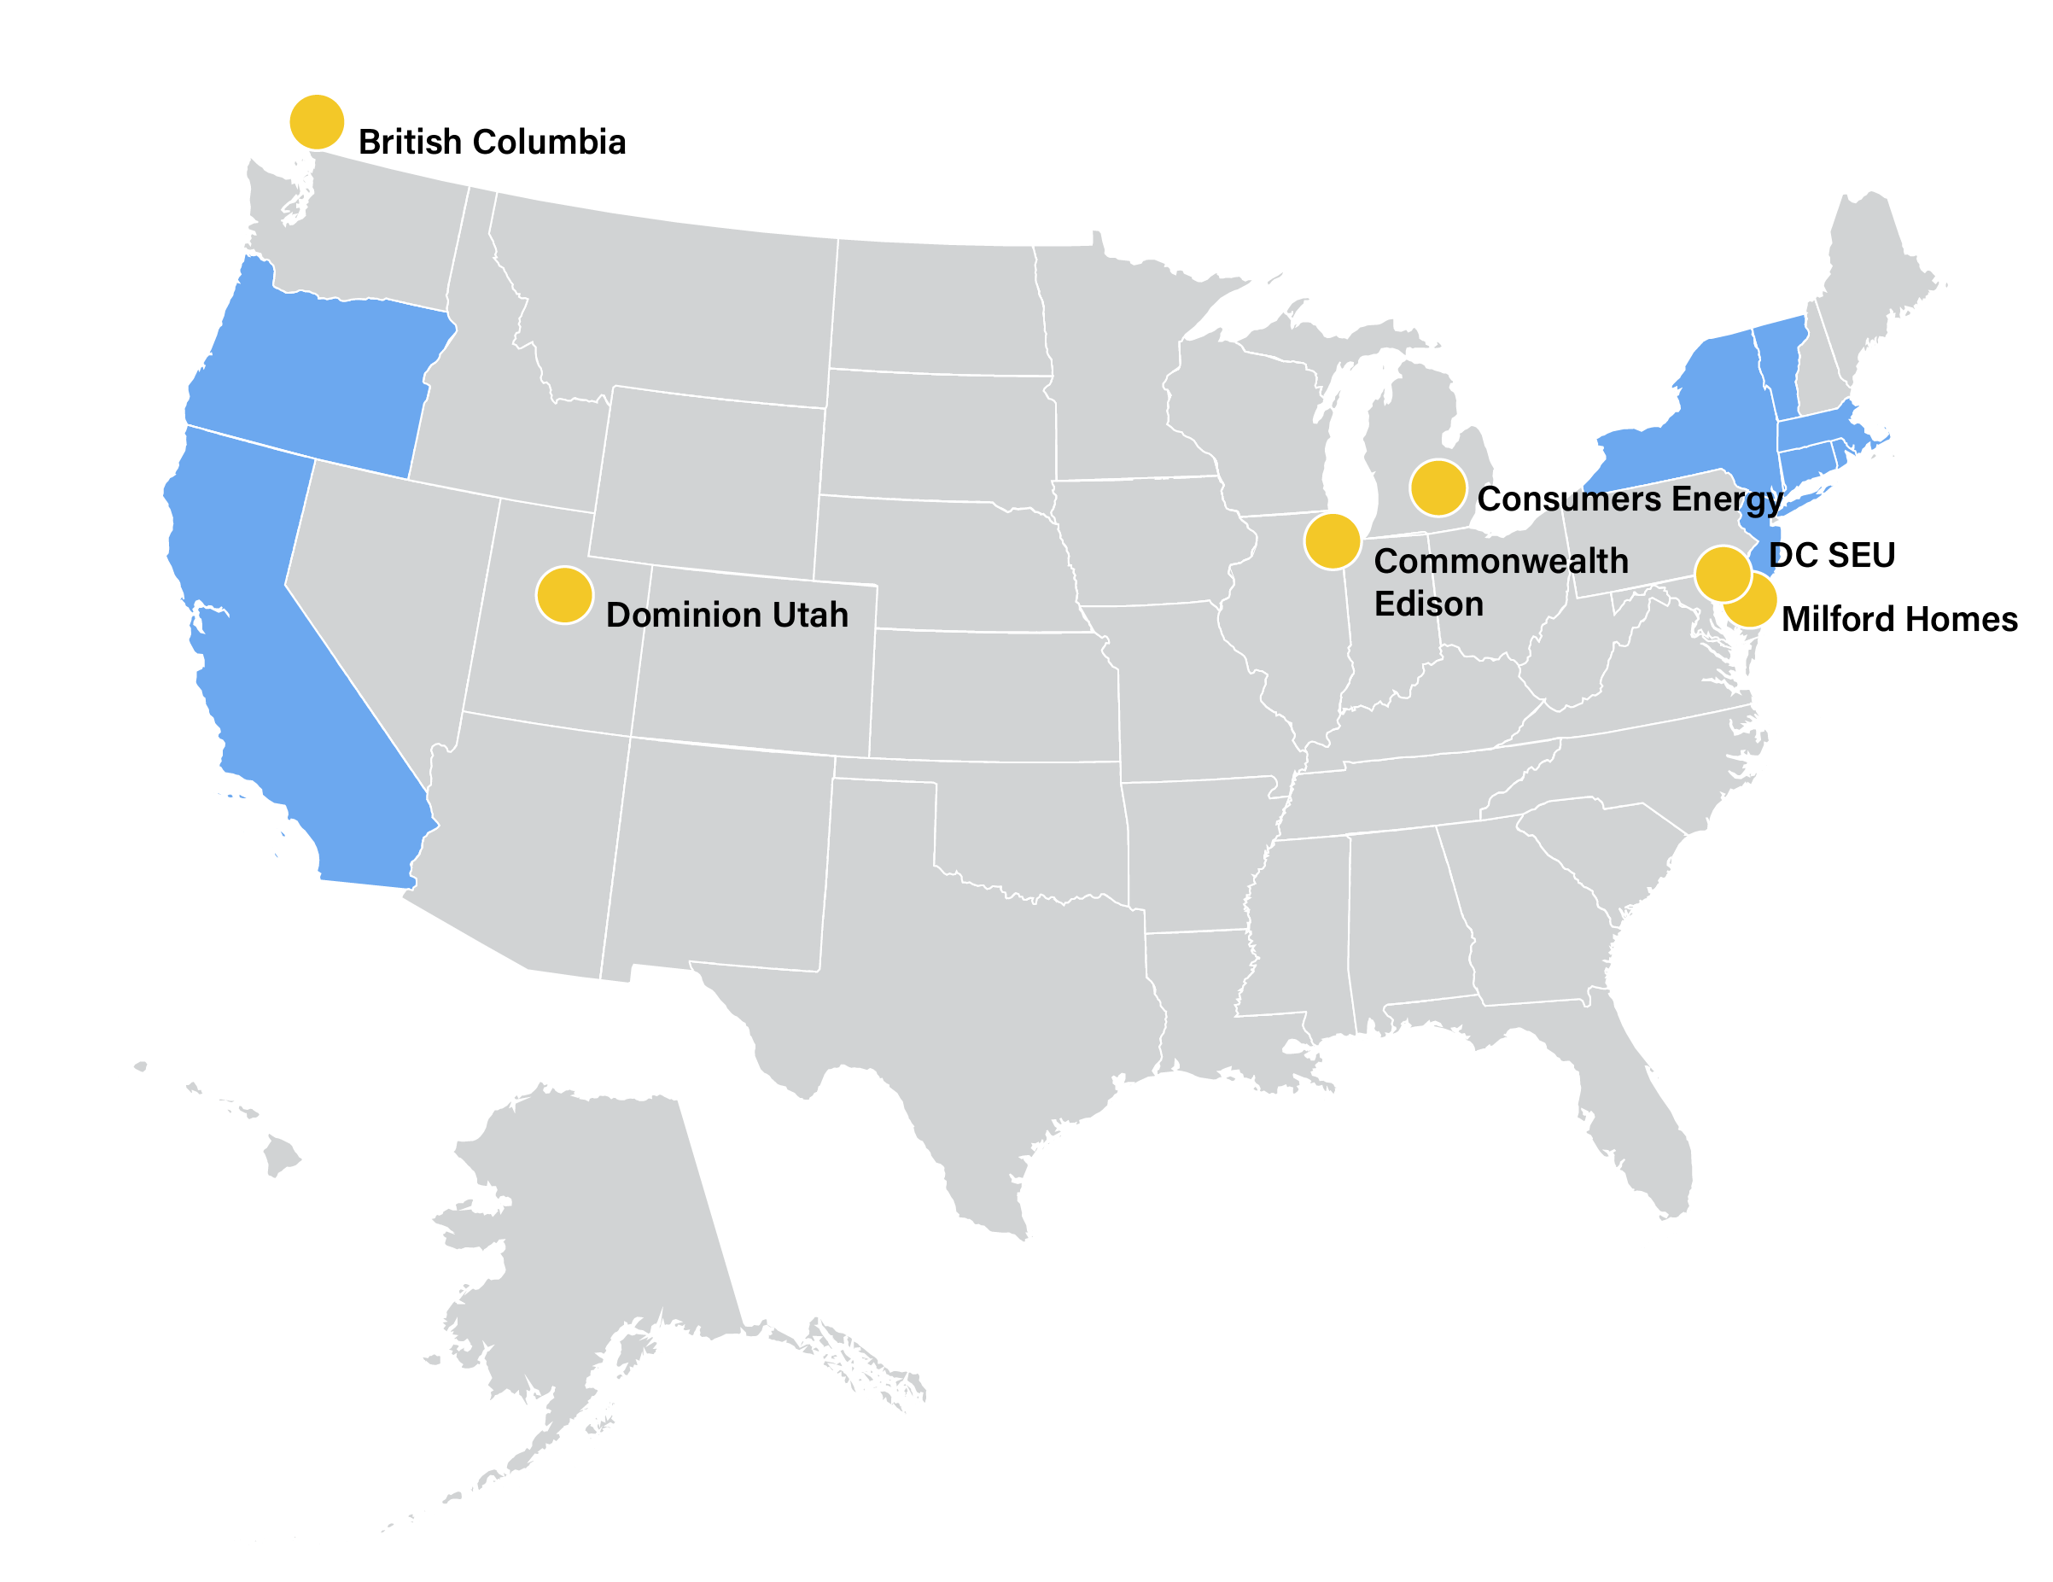
Zero Energy Home and Building Programs
Source: ACEEE, 2020, Programs to Promote Zero Energy
Homes and Buildings

Slide 9
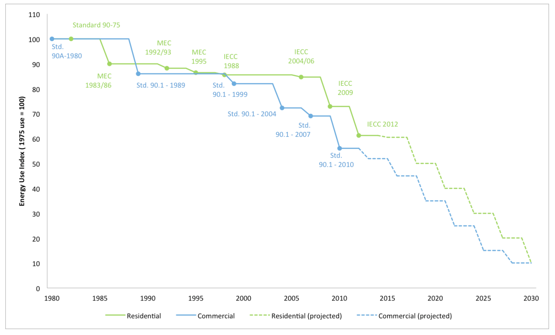

Building Code Progress

Slide 10
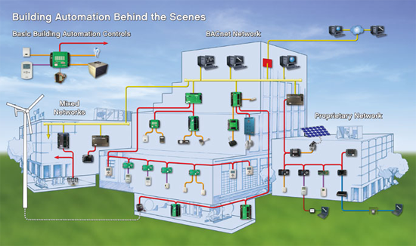
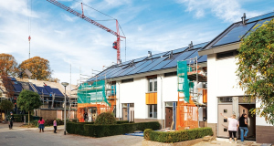
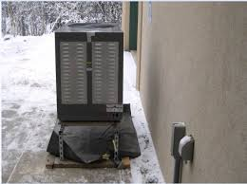
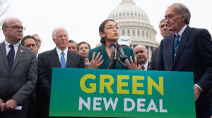
Upgrades to Existing Buildings & Homes
Energy efficiency upgrades and smart control technologies; electrification of remaining loads.

Slide 11
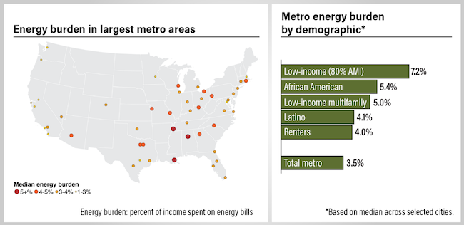
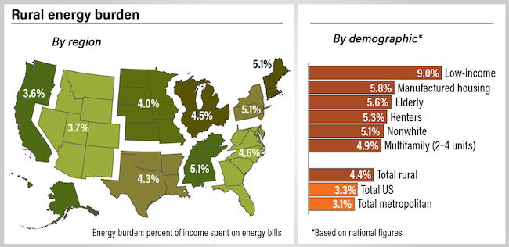
Addressing Equity Critically Important

Slide 12
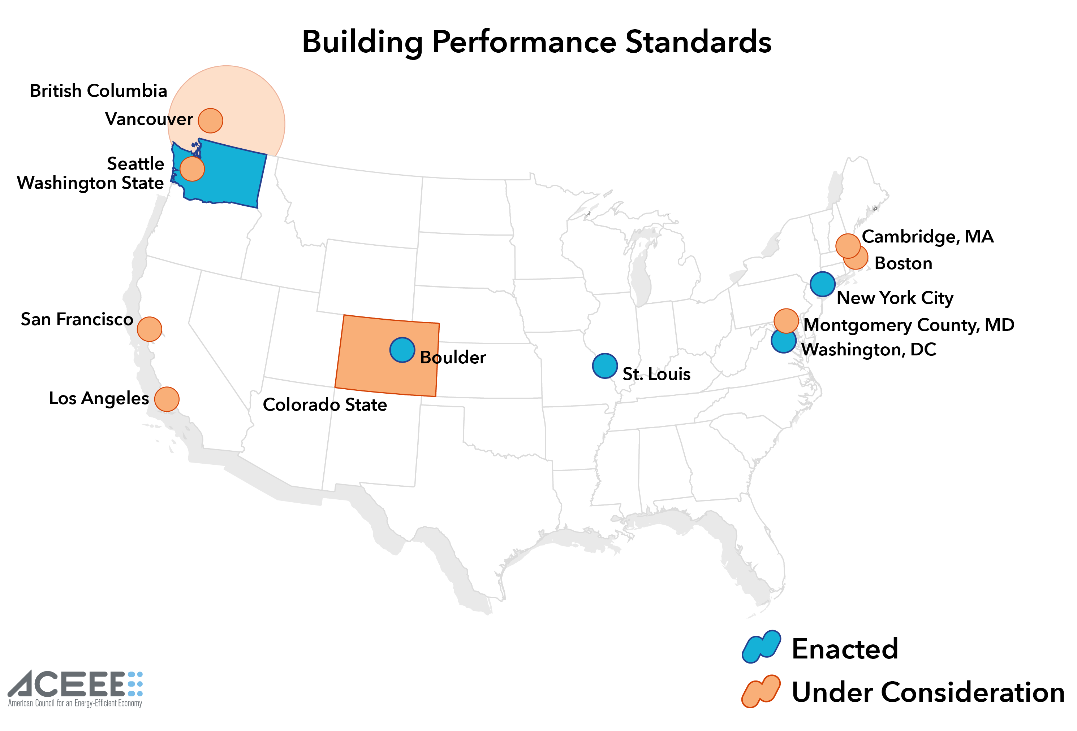

Slide 13
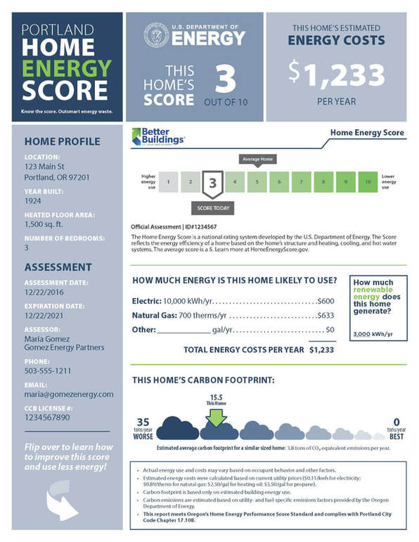
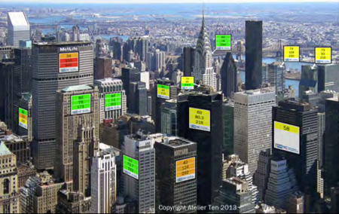
Other State and Local Policies to Promote Retrofits
Building and home benchmarking and labeling (e.g. time-of-sale home energy reports in Portland, Berkeley, Minneapolis and Austin.
Job training, weatherization programs
Commercial building energy audit, retrocommissioning and lighting upgrade requirements.

Slide 14
Potential Recovery Investments

Slide 15
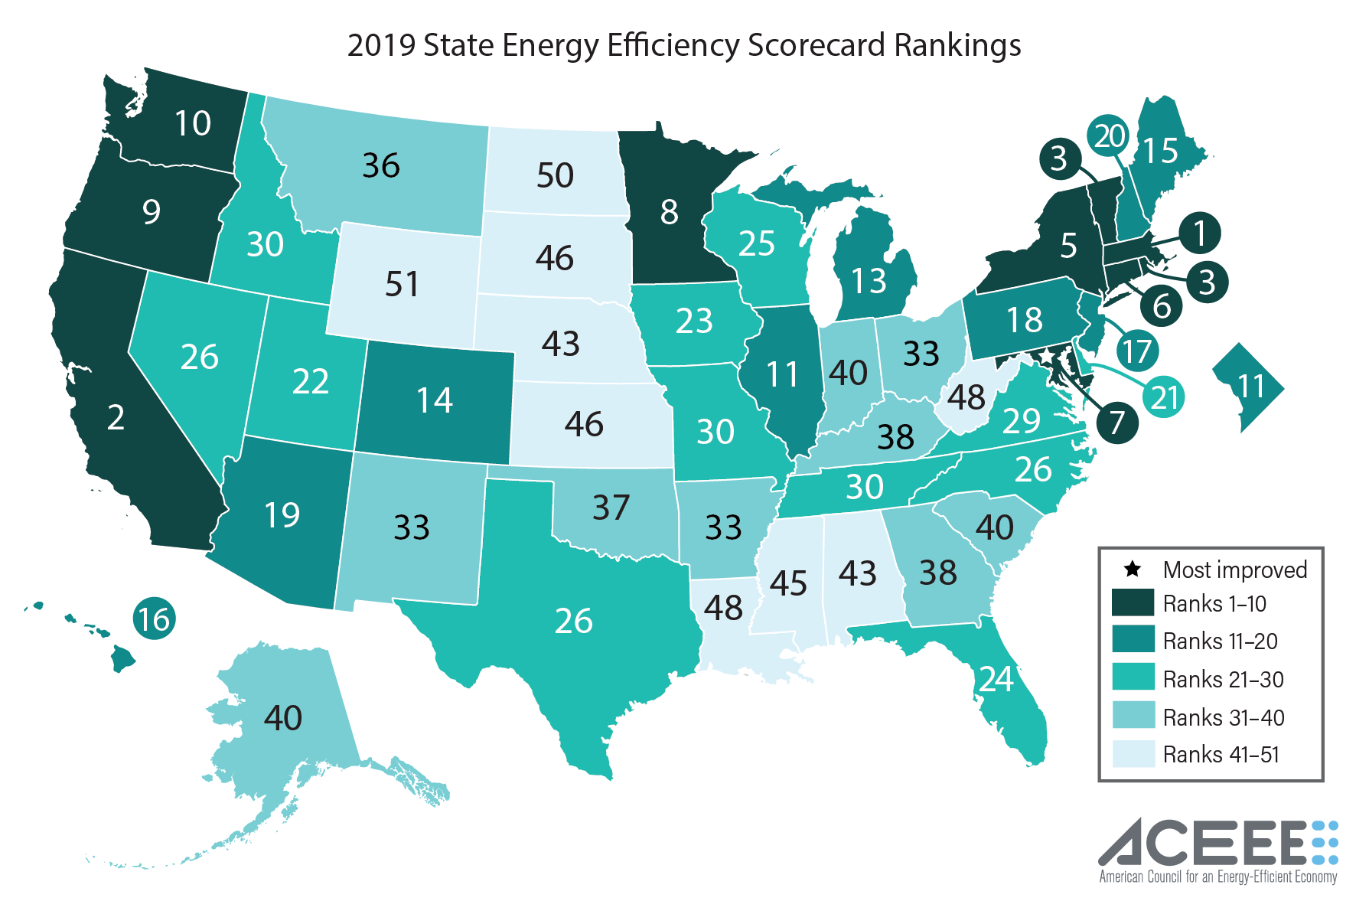

Slide 16
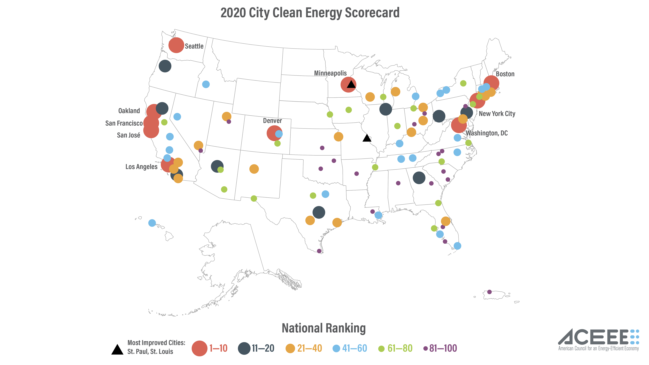

Slide 17

Conclusion
Efficiency can slash greenhouse gas emissions, getting roughly halfway to our long-term energy and climate goals.
Policies will be critical for reaching climate goals.
There are many programs and policies activists can and should promote.

Slide 18

Contact Information
Steven Nadel
snadel@aceee.org
“747”, Winner 2020 “Fat Bear” Competition

